Slide 1
AJAYKUMAR K
NMID: 8600E08FDC728C685794491E9FF1C9D3
Course : Generative AI for Engineering (E2324)
Madras Institute of Technology Campus, Anna University
Facial Image Synthesis with DCGAN: A Deep Learning Approach(FACEGAN)
Final Project :

Slide 2
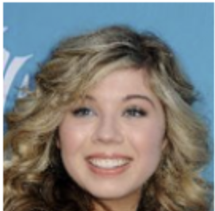

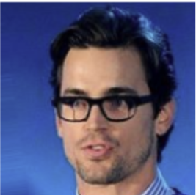

PROJECT TITLE
Facial Image Synthesis with DCGAN: A Deep Learning Approach

Slide 3


AGENDA
The agenda of the FaceGAN project is to utilize Deep Convolutional Generative Adversarial Networks (DCGANs) implemented with deep learning techniques and PyTorch to manipulate art images.
By employing DCGANs, the project aims to generate new data resembling the statistics of a given training set, particularly focusing on manipulating drawings.
Emphasis is placed on capturing the diverse textures, colors, and compositions characteristic of various face images to ensure the realism of the generated images.

Slide 4

PROBLEM STATEMENT
One challenge in medical training and simulation is the limited availability of diverse and realistic patient scenarios for trainees to practice diagnosing and treating various conditions.
Traditional methods often rely on static images or standardized patient actors, which may not accurately represent the full spectrum of patient demographics, conditions, and emotional states encountered in clinical practice.

Slide 5

PROJECT OVERVIEW
Process of leveraging Generative Adversarial Networks (GANs) to manipulate images of face :
Initially, a dataset of face images is acquired and preprocessed to ensure uniformity and suitability for training.
Following this, the DCGAN model architecture is developed, comprising a discriminator and generator network designed to generate realistic face images.
Through iterative training, the model learns to generate images that closely resemble those in the training dataset, with the discriminator simultaneously improving its ability to distinguish between real and generated images.

Slide 6
PROJECT OVERVIEW - CONT
The trained DCGAN model undergoes evaluation to assess its performance qualitatively and quantitatively, ensuring the generated images are realistic and of high quality.
Further fine-tuning and optimization may be applied based on evaluation results to enhance the model's performance.
Upon successful training and evaluation, the DCGAN model is deployed for practical applications such as generating new face images for various purposes.

Slide 7

WHO ARE THE END USERS?
Researchers and Developers: The primary users might be researchers and developers in the field of computer vision and deep learning. They could use the model for further research, experimentation, and development of new techniques in image synthesis and related areas.
Artists and Designers: Another group of potential users could be artists and designers who are interested in generating synthetic facial images for various creative purposes such as character design, animation, or digital art.
Entertainment Industry Professionals: Professionals in the entertainment industry, including filmmakers, video game developers, and special effects artists, might use such a model to generate realistic facial images for characters in movies, games, or other digital media productions.

Slide 8
WHO ARE THE END USERS? - CONT
Forensic Scientists: Forensic scientists and law enforcement personnel could potentially use such technology for generating facial composites of suspects based on eyewitness descriptions or for facial reconstruction from skeletal remains.
Medical Professionals: Medical professionals might also find applications for facial image synthesis, such as generating synthetic facial images for patients undergoing cosmetic surgery or reconstructive procedures.
Privacy and Security Researchers: Researchers and professionals
concerned with privacy and security might explore the implications of such technology for generating synthetic facial images and its potential use in scenarios such as anonymizing sensitive data or generating training data for facial recognition systems without compromising privacy.

Slide 9
YOUR SOLUTION AND ITS VALUE PROPOSITION
Our solution provides an optimized DCGAN architecture for realistic facial image synthesis, trained on diverse datasets. Through rigorous evaluation, we ensure high-quality and diverse representation, applicable across domains like entertainment, forensics, and medicine, offering versatile synthetic facial images for various needs with confidence in their fidelity and accuracy.
Efficiency: Streamlines the process of obtaining visual assets by automating image generation, saving time and effort for users.
Flexibility: Allows for customization of images to suit specific requirements, offering adaptability across different applications.
Quality: Ensures high-quality, realistic images that meet the standards of end users across various industries.

Slide 10

THE WOW IN YOUR SOLUTION
Realism Beyond Expectations: The generated face is realistic, often indistinguishable from professionally captured photographs. Users can access authentic-looking images without the need for costly and time-consuming photoshoots or extensive editing processes.
Instant Customization: Users have the power to customize generated images swiftly to align with their specific needs and preferences. Whether adjusting compositions, colors, or backgrounds, the solution offers immediate and intuitive customization options.
Rapid Access and Adaptation: The solution's efficiency enables lightning-fast access to a vast array of high-quality face images with quick generation times and seamless integration into various workflows.
10

Slide 11
MODELLING
Network Architecture Design: Designing the discriminator and generator networks with convolutional layers and appropriate activation functions for binary classification and image generation.
Data Pre-processing: Pre-processing the face image dataset(celebA) by resizing, cropping, and normalizing pixel values to prepare it for training.
Hyperparameter Optimization: Experimenting with different hyperparameters like learning rate, batch size, and network architecture parameters to find the optimal settings for training the DCGAN model.
Training Process: Iteratively updating the discriminator and generator networks using adversarial training to produce realistic face images.
Evaluation and Validation: Assessing the performance of the trained DCGAN model through visual inspection, quantitative metrics, and subjective evaluations to ensure the quality of generated images meets standards.
11

Slide 12
RESULTS
Visual Quality of Generated Images: The primary outcome of the project is the quality of the generated face images. The success of the DCGAN model is evaluated based on how closely the generated images resemble real face items. High-quality results demonstrate the effectiveness of the model in capturing the characteristics, textures, and details of various face items.
Quantitative Metrics and Evaluation: Quantitative metrics such as Frechet Inception Distance (FID) were utilized to objectively assess the similarity between generated and real face images. The FID scores indicated a close resemblance between the generated and real images, further validating the quality and realism of the generated face items.
Overall, the project's results demonstrated the capability of the DCGAN model to generate realistic face images of exceptional quality.
12

Slide 13
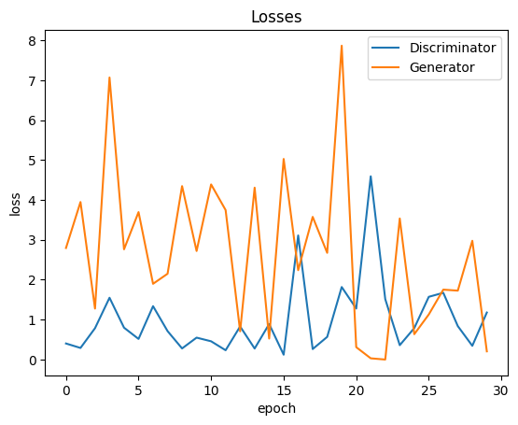
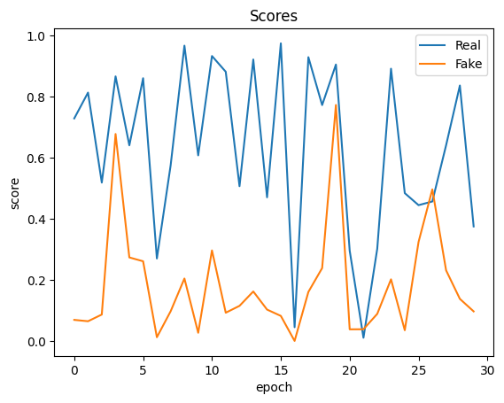
RESULTS - CONT
Ideally, as the number of epochs increases, the generator will get better at creating realistic data, and the discriminator will get worse at telling the difference between real and fake data. This can be seen in the graph as a downward trend in both the generator and discriminator loss lines.
13

Slide 14
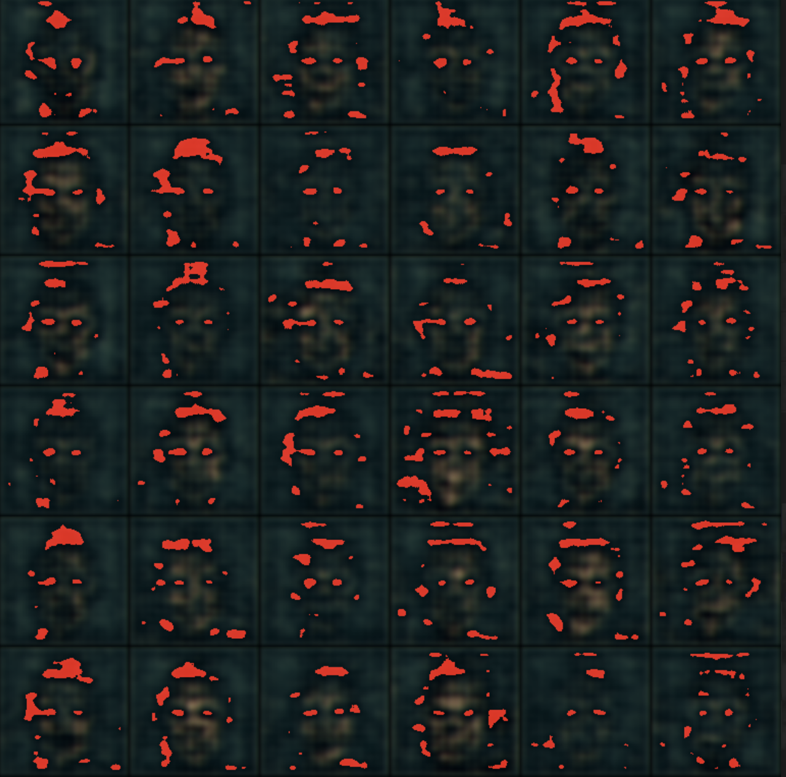
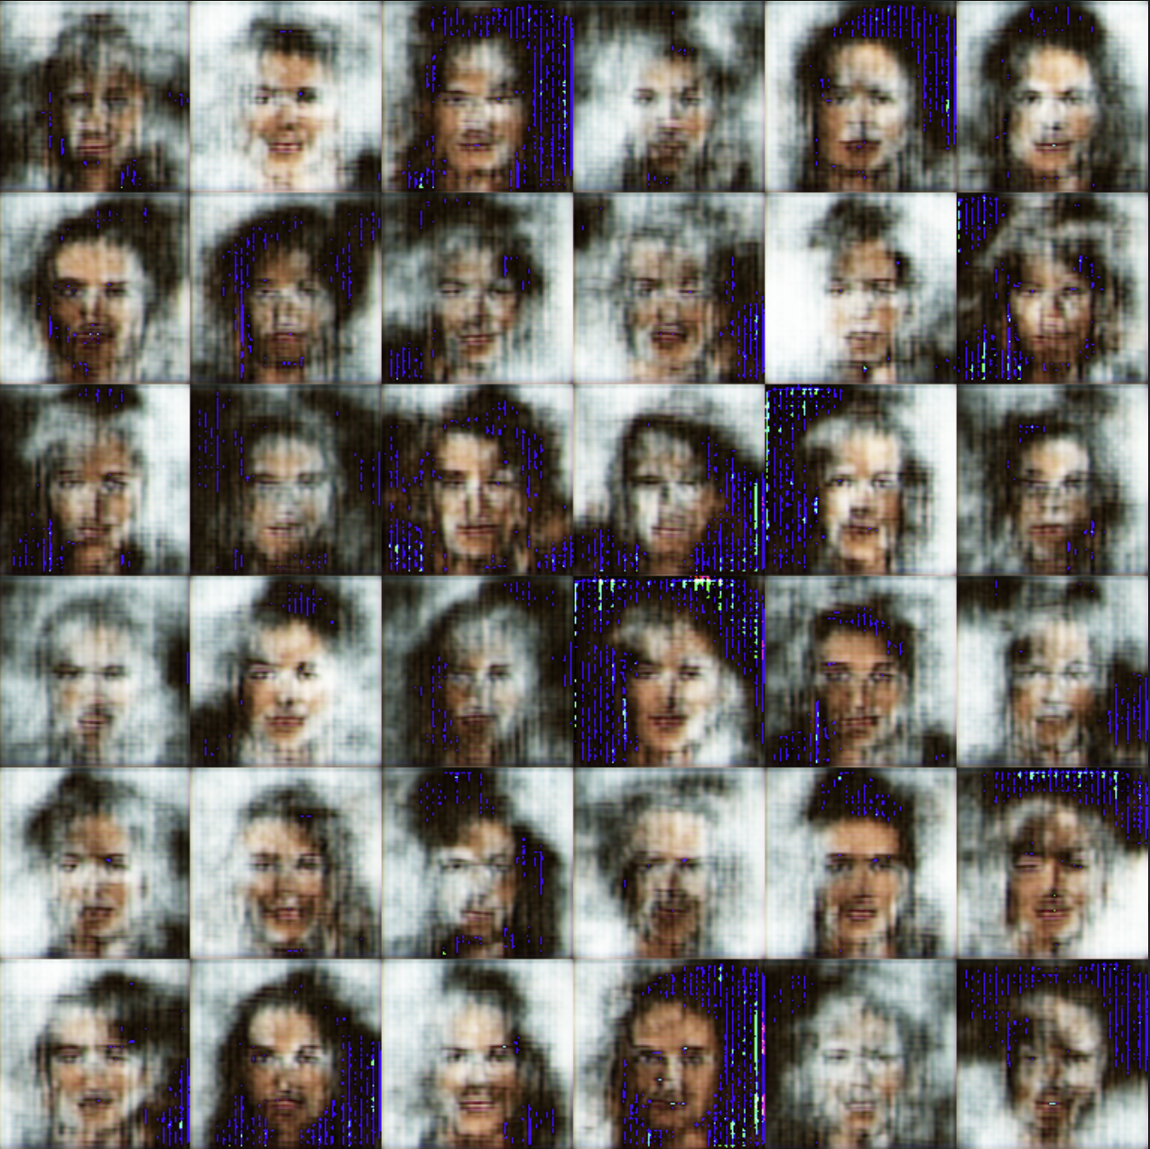
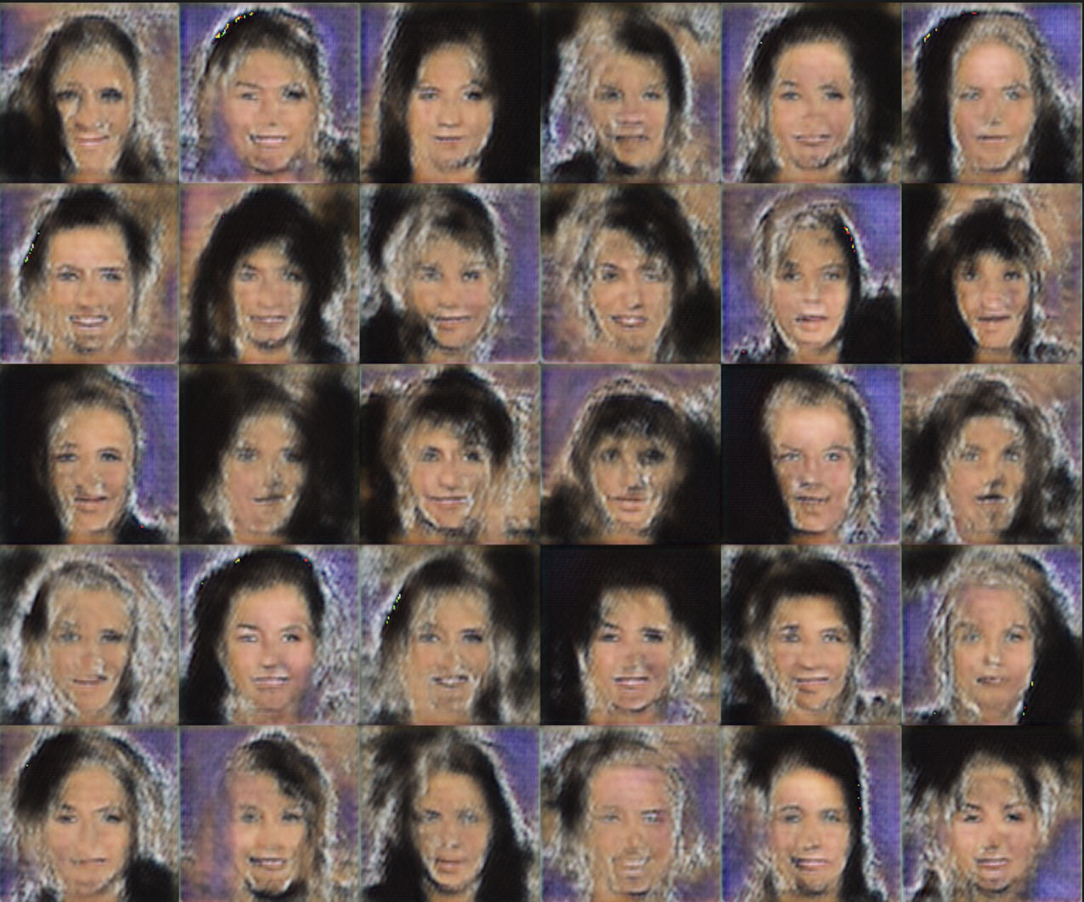
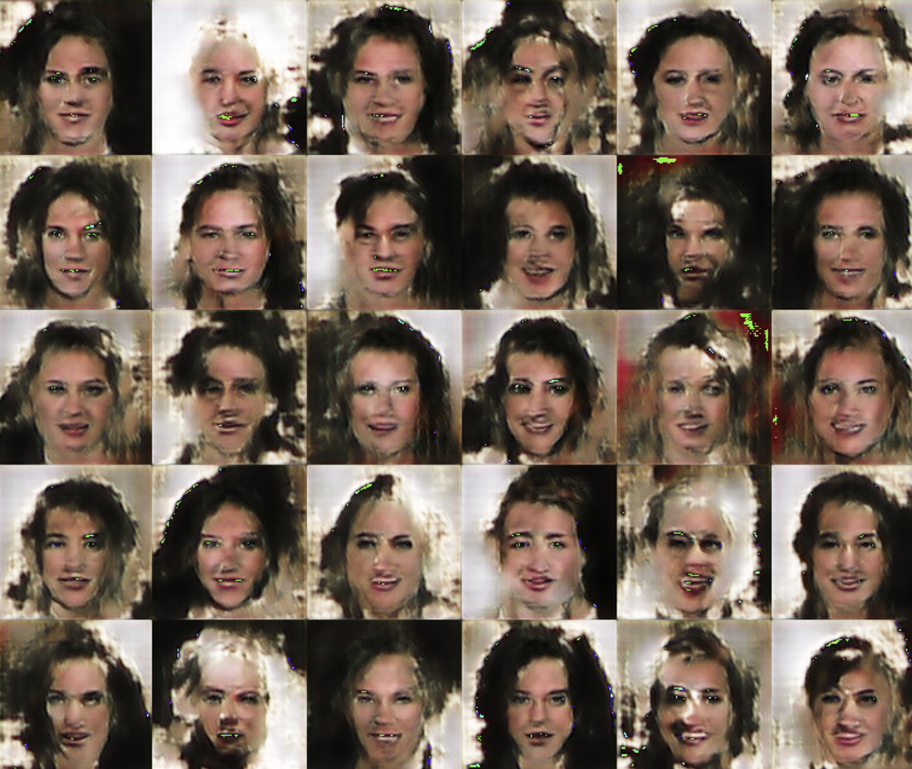
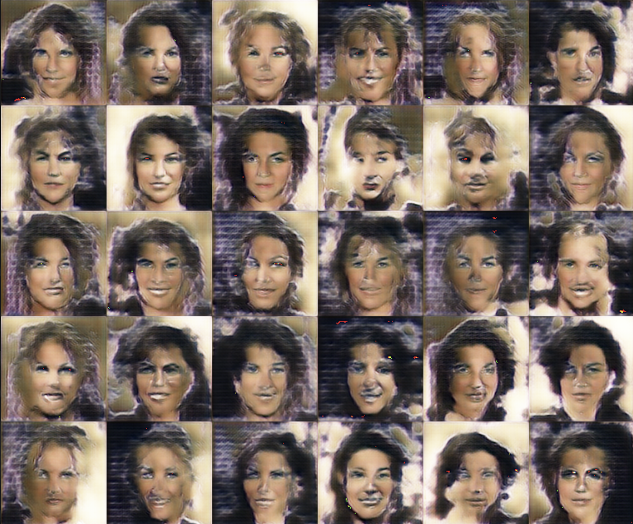
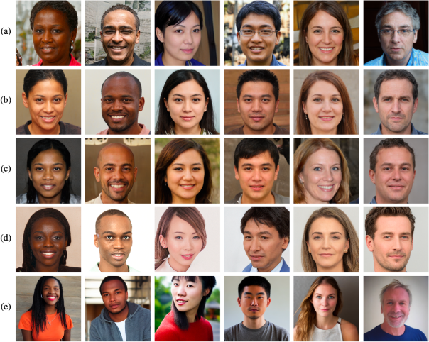
RESULTS - CONT
FAKE GENEARTED IMAGES
14

Slide 15
THANK YOU

